Slide 1
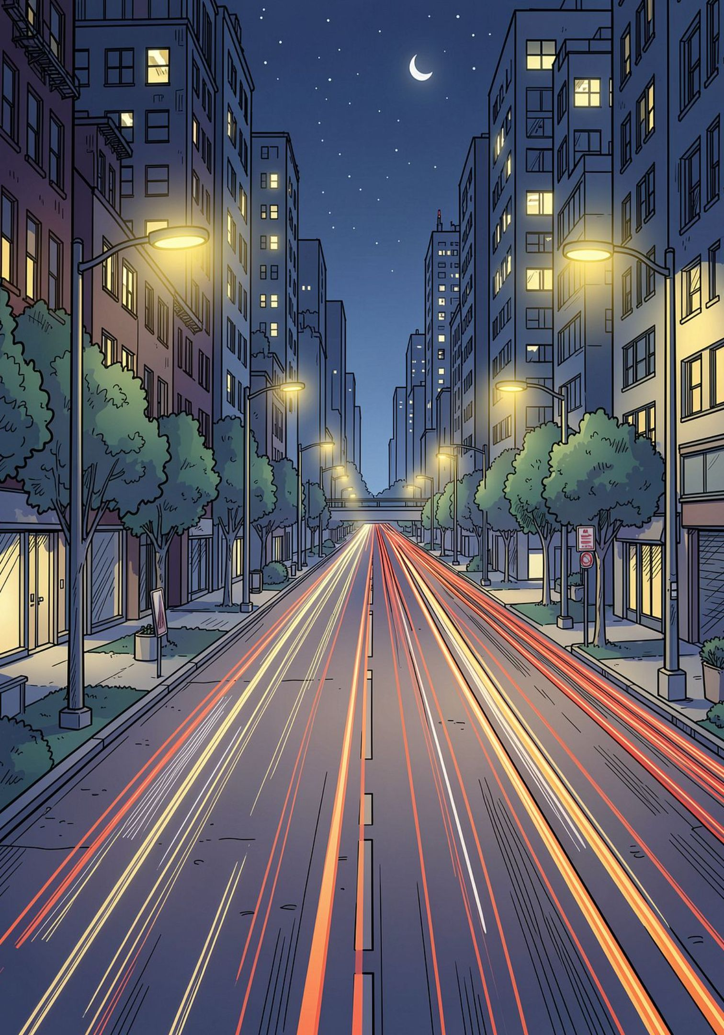
Design and Simulation of an Automatic Street Light Control System
DDCA Project Presentation
Presented by:
P.Naga Sai Venkat Praveen — 2620040078
N. Varun — 2620040048
G.Ritesh— 2620040016
P.Sujith Kumar — 2620040027
Department of Digital Design and Computer Architecture (DDCA)
Koneru Lakshmaiah Education Foundation (KLEF)
Hyderabad Campus, Bachupally
Academic Year: 2026

Slide 2
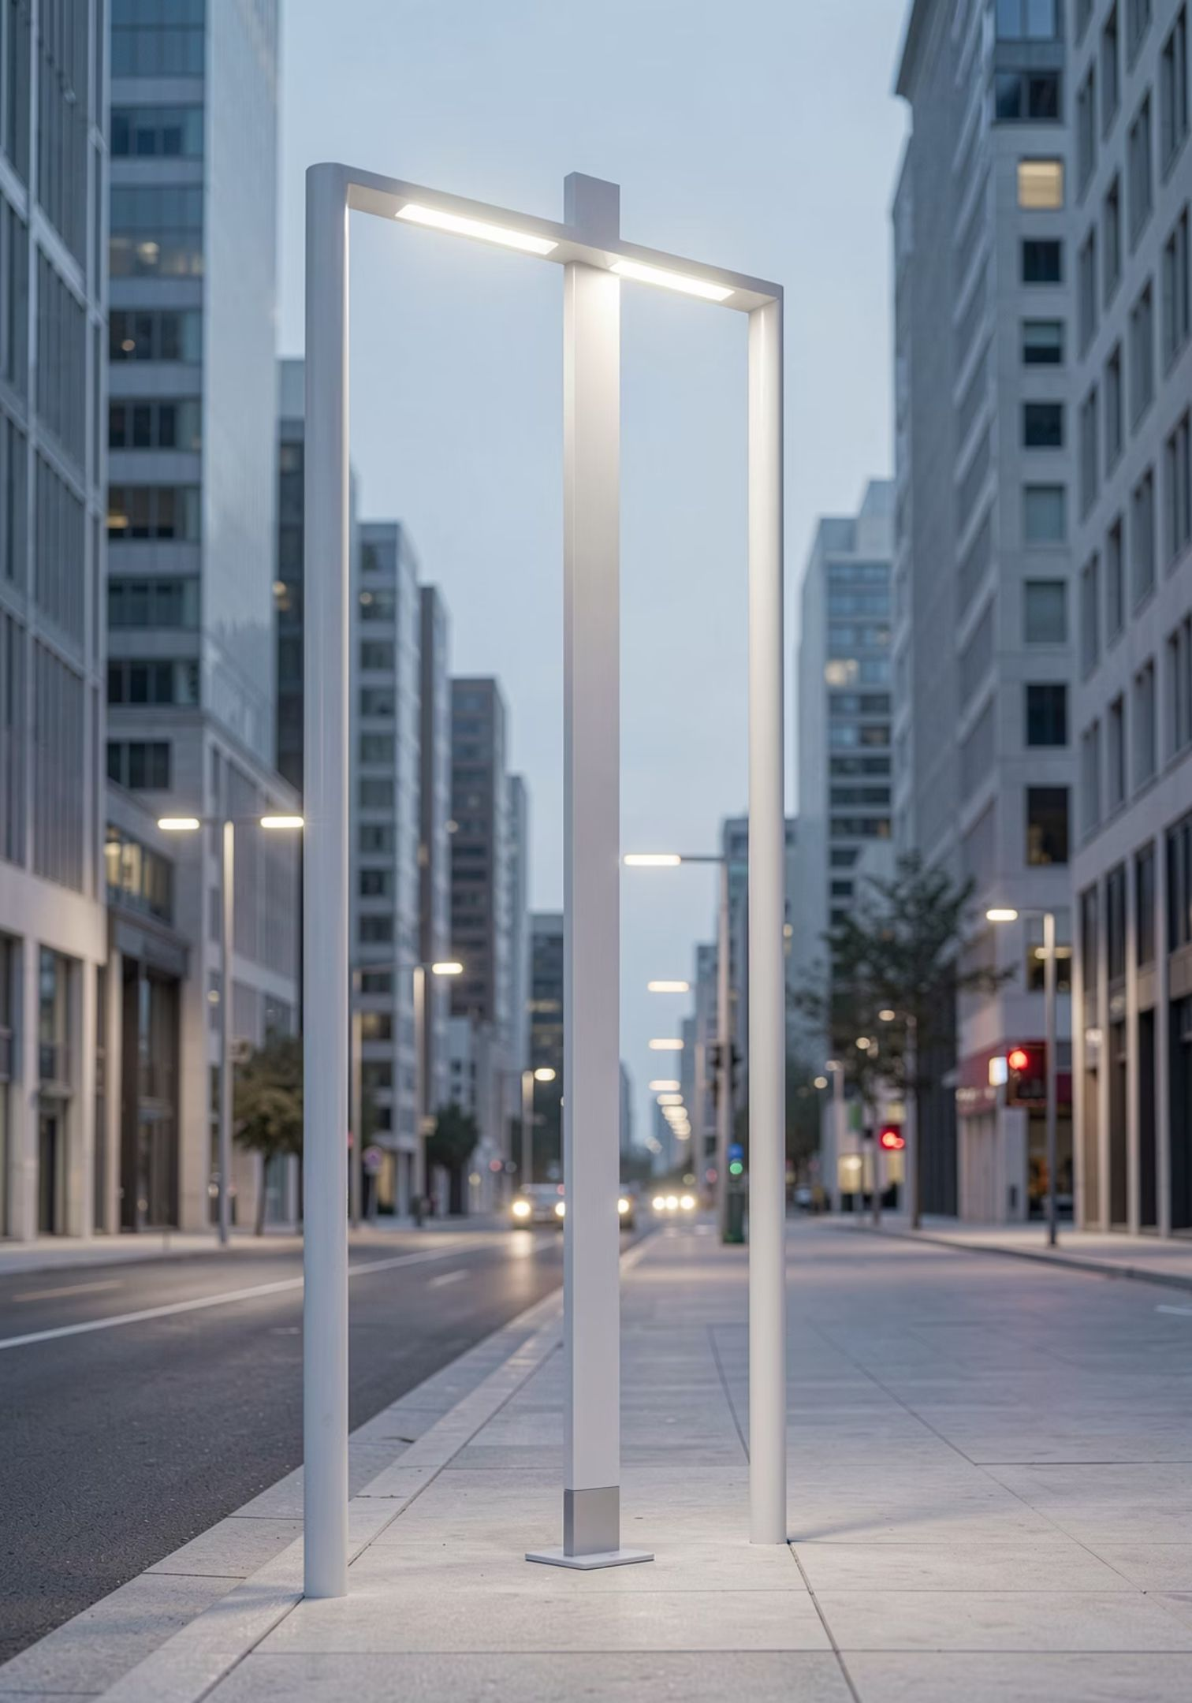
Introduction: Smart Street Lighting for a Brighter Future
Our project introduces an advanced Automatic Street Light Control System, designed to revolutionize urban illumination. By integrating sensor technology and intelligent algorithms, this system aims to optimize energy consumption, enhance public safety, and reduce operational costs.
We delve into the detailed design and simulation of a solution that dynamically adjusts lighting levels based on real-time environmental conditions, paving the way for more sustainable and efficient city infrastructure.

Slide 3
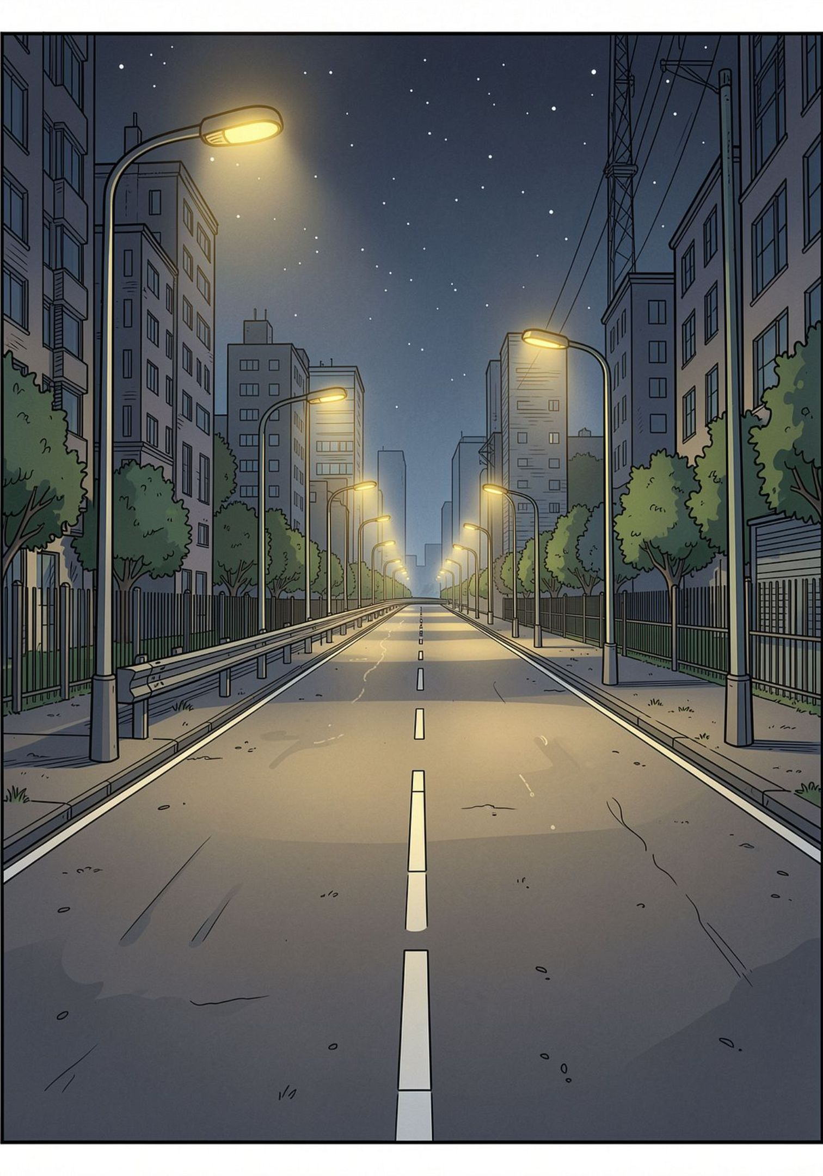
The Problem: Energy Waste in Street Lighting
Always-On Lighting
Manual control and fixed timers keep lights on at full brightness even on empty roads.
High Energy Demand
Conventional street lighting consumes a major share of a city's total electrical energy budget.
Human Error & Seasonal Drift
Manual operation is susceptible to human error and fails to adapt to seasonal timing variations.

Slide 4

Project Objectives
1
Automate ON/OFF Control
Use ambient light sensing (LDR) to switch street lights automatically based on day/night conditions.
2
Dynamic Brightness Adjustment
Detect motion via IR/PIR sensors and adjust lamp brightness in real time for safety and efficiency.
3
Reduce Consumption & Extend Lifespan
Lower overall energy use and reduce wear on LED lamps through intelligent dimming and switching.

Slide 7
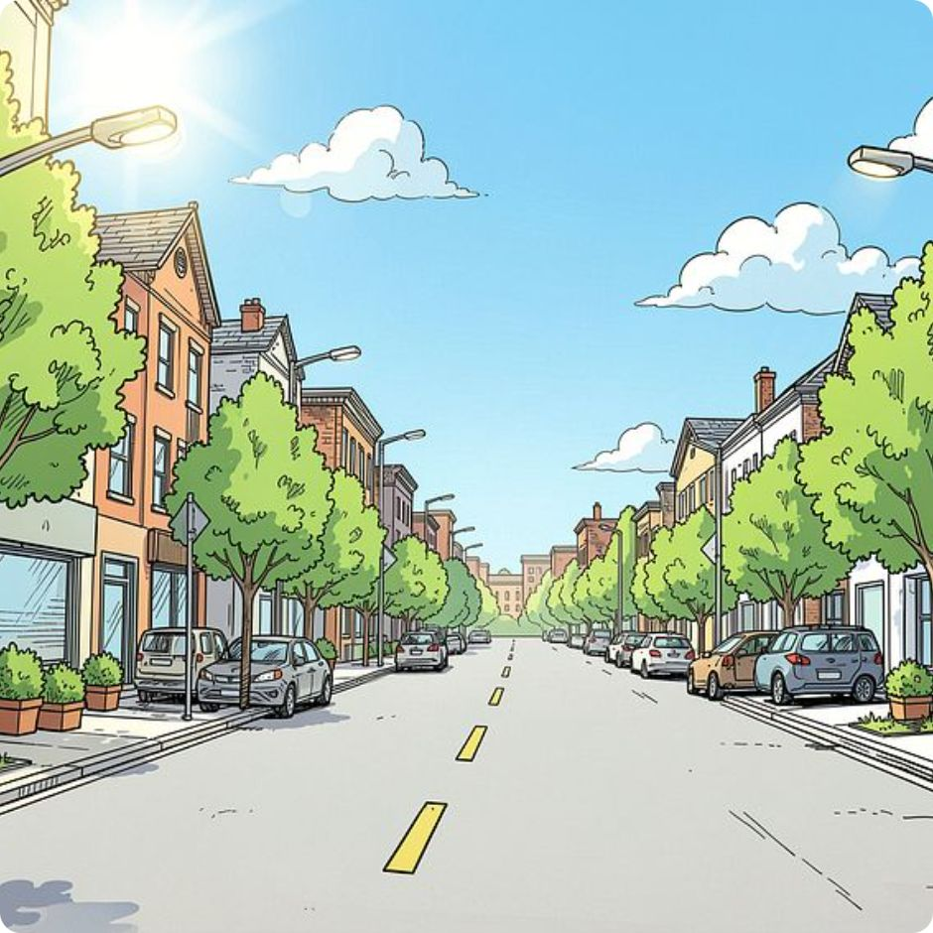
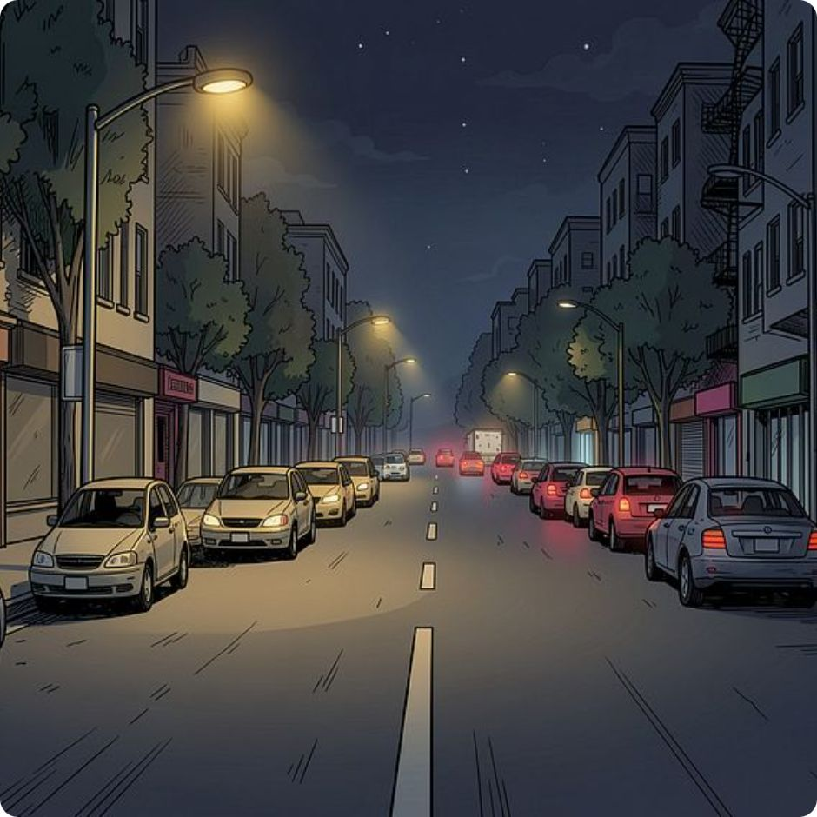
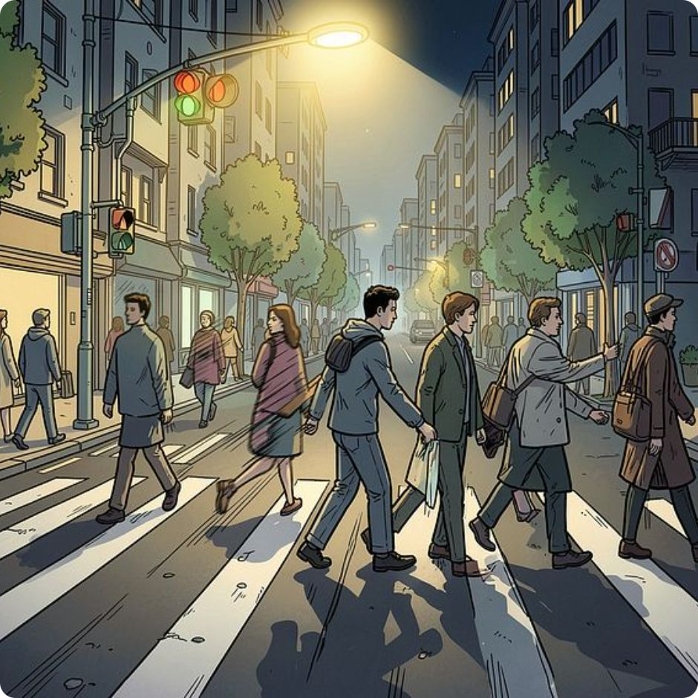
Working Principle
Daytime
Night — No Motion
Night — Motion Detected
LDR detects sunlight → lamp stays OFF, conserving energy throughout daylight hours.
Lamp operates at a dim level for baseline visibility and significant energy savings.
IR/PIR triggers lamp to switch to full brightness immediately for pedestrian and vehicle safety.

Slide 8

Control Logic & Implementation
Basic Approach
A transistor circuit operates in saturation (ON) and cut-off (OFF) regions to switch the lamp based on sensor input — a straightforward digital logic implementation.
Advanced Approach
A microcontroller divides the night into time slots and applies Pulse Width Modulation (PWM) for variable brightness control, enabling fine-grained energy management.
Simulation Tools
Proteus 8 — circuit-level simulation and validation
Quartus & Verilog HDL — FPGA-based digital design and synthesis

Slide 9
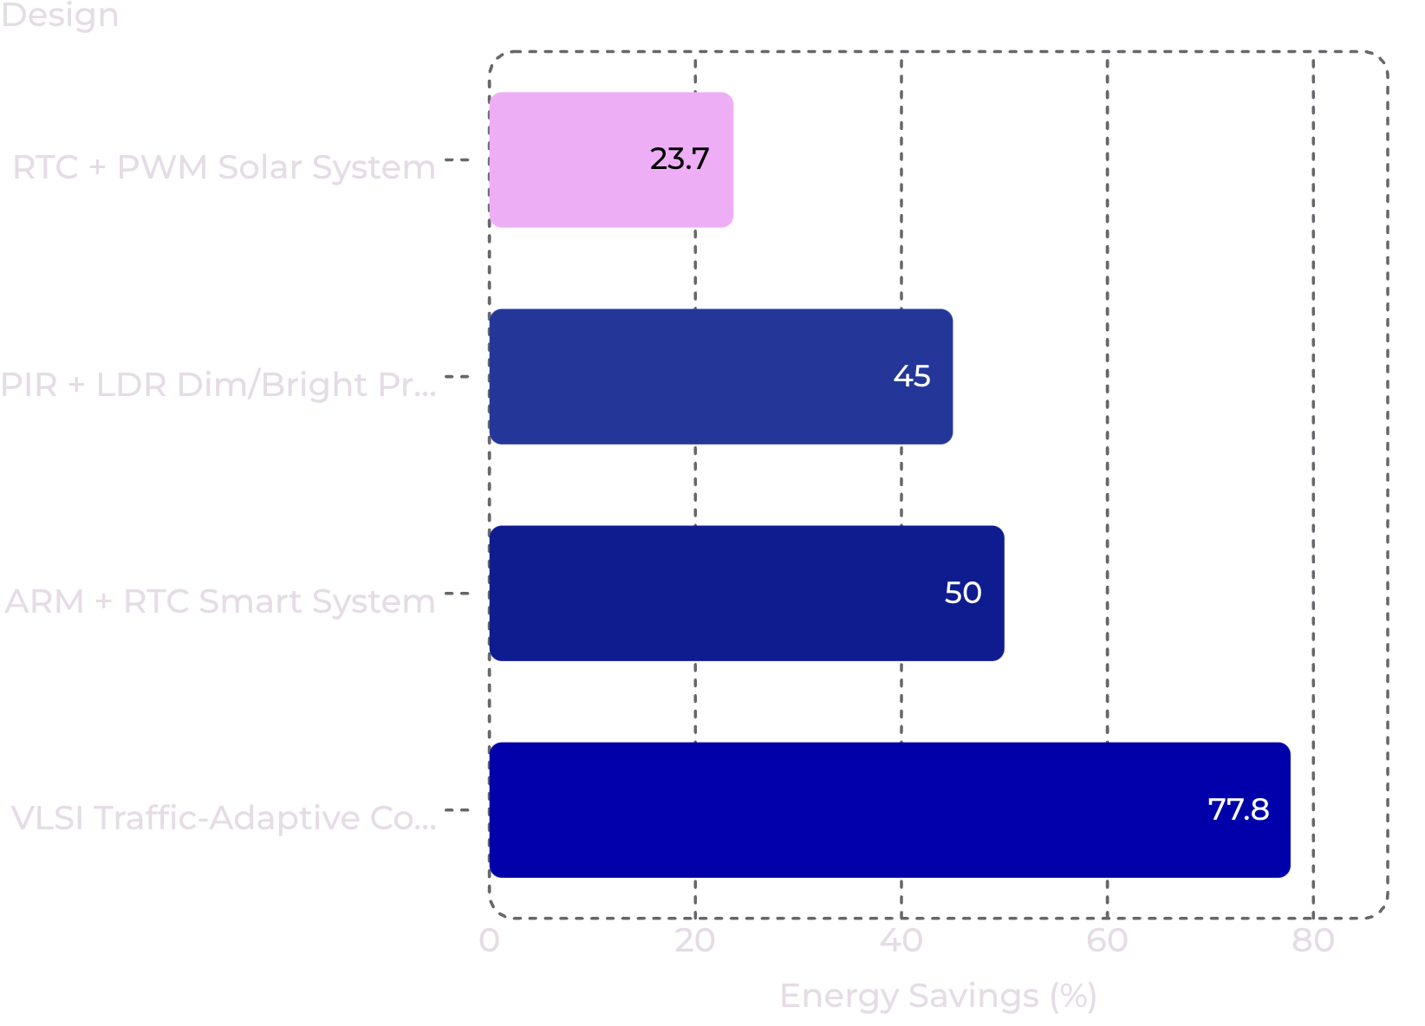

Results: Energy Savings Across Designs
Key Findings
Across all reviewed designs, intelligent street light controllers consistently outperform conventional fixed-timer systems:
RTC + PWM solar system: 23.7% energy savings
PIR + LDR dim/bright prototype: ~45% estimated reduction
ARM + RTC smart system: 50% excess power reduction
VLSI traffic-adaptive controller: 77.78% power reduction
More sophisticated sensing and control logic yields dramatically greater energy savings.

Slide 10
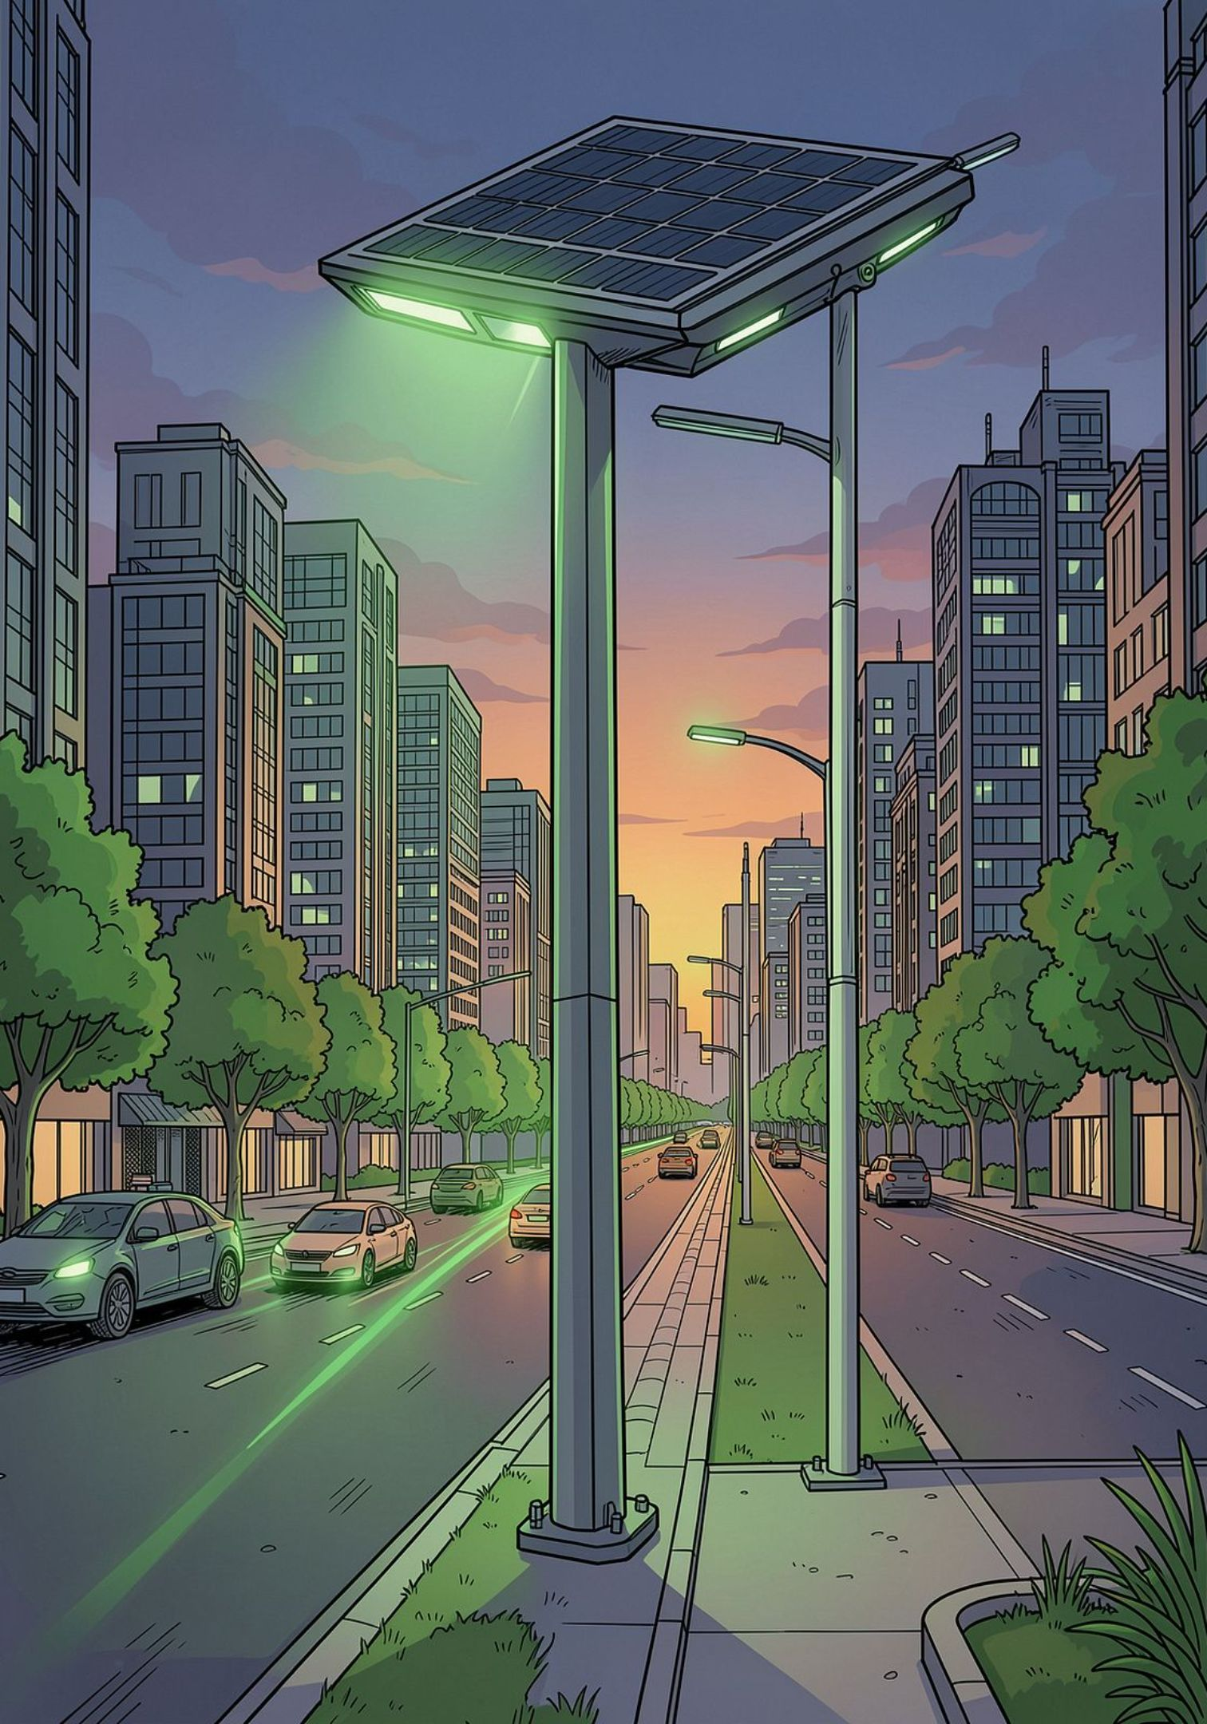
Key Advantages & Impact
Energy Efficiency
Avoids unnecessary full-night lighting by dimming when roads are empty, cutting consumption significantly.
Improved Safety
Instantly brightens when people or vehicles are detected, ensuring visibility exactly when it matters.
Lower Maintenance
Automation and fault monitoring reduce manual intervention and extend LED lamp lifespan.
Renewable Integration
Supports solar-powered operation, enabling fully off-grid and sus

Slide 11
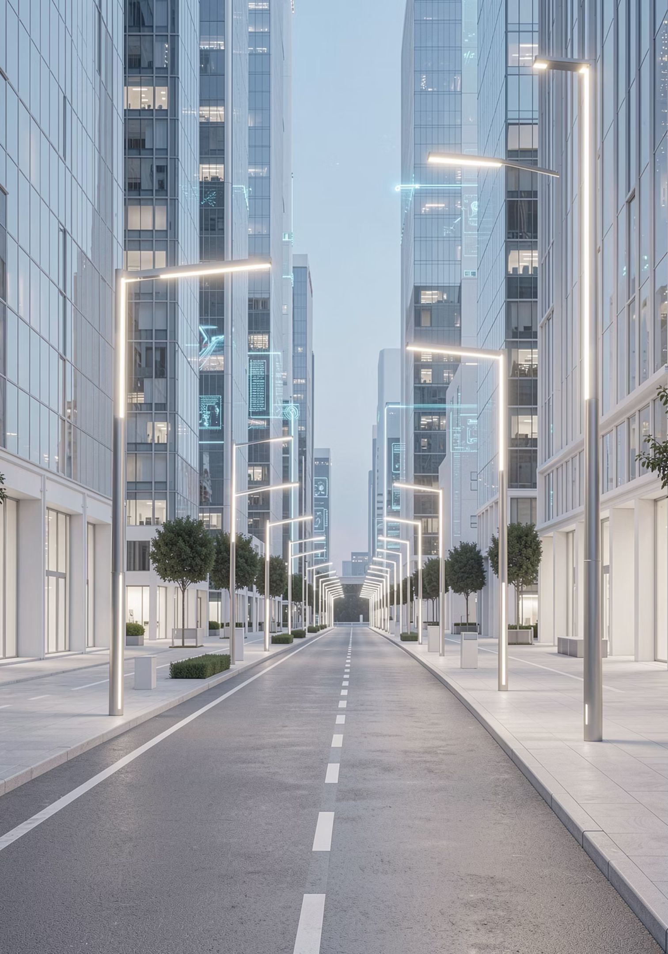
Conclusion
Our project successfully designs and simulates an automatic street light control system that addresses significant energy waste in conventional setups. By dynamically adjusting lighting based on real-time ambient conditions and motion detection, the system achieves substantial energy savings, enhances public safety, and reduces operational costs.
This intelligent solution represents a crucial step towards creating smarter, more sustainable urban infrastructures, contributing to a greener future with improved efficiency and responsiveness.

Slide 12
